Slide 1
Web scraping for company info
Current method

Slide 2
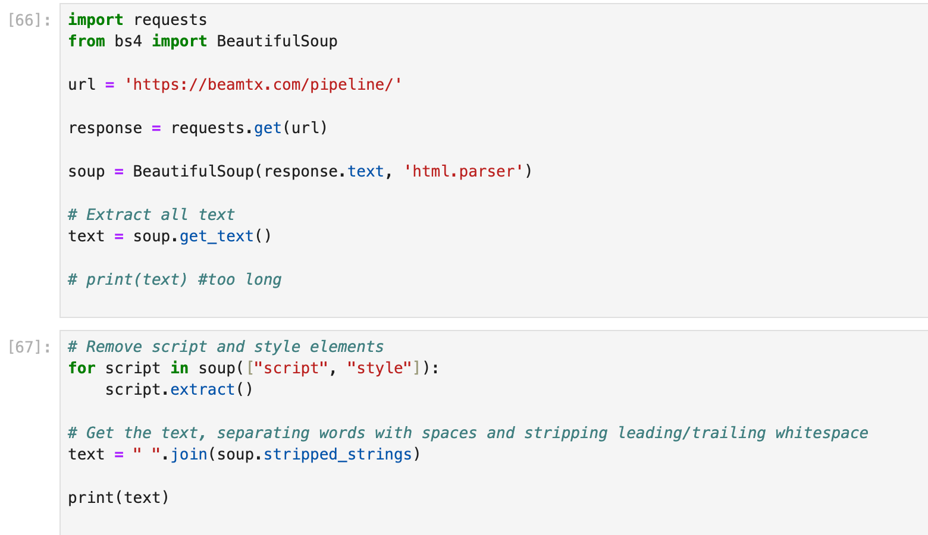
I wrote a web-scraper (GPT-generated) Example: Beam Therapeutics

Slide 3
Output: Text
Pipeline | Beam Therapeutics Skip to main content About us Science Go to Science Base Editing Base Editing Applications Additional Technologies Posters and Presentations Pipeline (current) Patients Go to Patients Commitment Our Research Expanded Access Investors Careers Contact Saved jobs 0 About us Science Go to Science Base Editing Base Editing Applications Additional Technologies Posters and Presentations Pipeline (current) Patients Go to Patients Commitment Our Research Expanded Access Investors Careers Contact Sitemap Privacy Policy Cookie Policy Terms of use © Beam Therapeutics. All rights reserved Search Jobs By Keywords Search Search Pipeline Broad and diversified portfolio We seek to potentially cure serious diseases and address significant unmet medical need so that people can reach their full potential. We believe leveraging ex vivo and in vivo approaches, different delivery modalities, and multiple editing approaches will help us target a broad range of diseases with limited or no disease-modifying treatment. Scroll horizontally to see more Lead programs Sickle cell disease Sickle cell disease (SCD) is a group of genetic disorders that affects hemoglobin, the molecule in red blood cells that delivers oxygen to cells throughout the body. People with this disease inherit two copies of a gene, each with a single letter misspelling. This misspelling causes production of atypical hemoglobin molecules called hemoglobin S, which can distort red blood cells into a sickle, or crescent, shape, blocking the flow of blood and oxygen throughout the body. The characteristic features of SCD begin in childhood and may include anemia, repeated infections, and episodes of pain. The severity of symptoms varies from person to person and throughout life. The diminished oxygen delivery to tissues and organs can lead to life-threatening complications, such as stroke and organ damage. Chronic organ damage is the leading cause of death in adults with SCD. Beam is advancing two ex vivo base editing programs, Beam-101 and Beam-102, in which cells are collected from a patient, edited, and then infused back into the patient. To create space for the edited cells to take hold in the bone marrow, patients undergo a conditioning regimen, such as treatment with busulfan, the standard of care in hematopoietic stem cell (HSC) transplantation today. BEAM-101 Edit type: Activation Delivery modality: Electroporation | Ex vivo Approach: Activation of fetal hemoglobin BEAM-101 is an investigational therapy that produces base edits designed to potentially alleviate the effects of sickle cell disease by mimicking genetic variants seen in individuals who have hereditary persistence of fetal hemoglobin. BEAM-102 Edit type: Gene correction Delivery modality: Electroporation | Ex vivo Approach: HbG-Makassar BEAM-102 is an investigational therapy designed to edit the causative hemoglobin S point mutation directly to recreate a naturally occurring normal human hemoglobin variant, HbG-Makassar. The Makassar variant is believed to be a normal- functioning variant of hemoglobin. LONG-TERM COMMITMENT TO SCD Today’s conditioning regimens are associated with significant toxic effects. Future improved conditioning regimens that produce fewer toxic effects could potentially be paired with BEAM-101 and BEAM-102 and with other future programs. Beam is also exploring the potential for in vivo base editing programs for SCD, in which base editors would be delivered to a patient through an infusion of lipid nanoparticles (LNPs) targeted to HSCs, eliminating the need for transplantation. This approach has the potential to provide a more accessible option for patients, particularly in regions where ex vivo treatment and transplantation are not widely accessible. T-cell cancers Chimeric antigen receptor T-cell (CAR-T) therapies have the potential to address a number of T-cell cancers, but their therapeutic potential is often hindered by technological limitations in their development and application. For example, approved CAR-T therapies are created from a patient’s own cells, which creates both technical and logistical challenges. To address these limitations, we are using multiplex base editing to create donor-derived CAR-T cells by simultaneously silencing multiple target genes, thereby potentially enabling universal compatibility and resistance to host rejection, fratricide, and immunosuppression. BEAM-201 Edit type: Multiplex editing Delivery modality: Electroporation | Ex vivo Approach: Gene silencing BEAM-201 is a multiplex base edited anti-CD7 CAR-T cell investigational therapy for relapsed and refractory T-cell acute lymphoblastic leukemia and T-cell lymphoblastic lymphoma, a severe disease affecting children and adults. Glycogen storage disease 1a Glycogen storage disease type 1a (GSD1a) is a serious, potentially life-threatening genetic disease with no approved disease-modifying treatments available to date. In patients who have GSD1a, glycogen accumulates in organs and tissues such as the liver, kidneys, and small intestine. The accumulation of glycogen (and sometimes fat) and inability to generate glucose during fasting can lead to severe and life-threatening hypoglycemia, seizures, metabolic dysfunction in lipids, short stature, liver adenoma, and renal disease. BEAM-301 Edit type: Gene correction Delivery modality: LNP | In vivo Approach: Correction of R83C mutation BEAM-301 is a liver-targeting LNP formulation of base editing reagents designed to correct the R83C mutation. R83C is the most common mutation responsible for causing GSD1a. Base Editing Applications Base editing is an emerging class of precision genetic medicines designed to overcome the limitations of existing approaches and expand the potential of genetic medicine. Our delivery strategy is to establish a suite of clinically validated technologies, including electroporation and nonviral and viral delivery modalities. Discover More About us Science Pipeline Patients Investors Careers Contact Sitemap Privacy Policy Cookie Policy Terms of use © Beam Therapeutics. All rights reserved Contact Us GENERAL INQUIRIES info@beamtx.com INVESTOR INQUIRIES investors@beamtx.com CAREER INQUIRIES careers@beamtx.com CLINICAL TRIAL INQUIRIES clinicalinfo@beamtx.com This website uses cookies. It uses cookies to ensure that it gives you the best experience on our website. If you continue without agreeing to the cookie conditions, we'll assume that you are happy to receive all cookies on this website. Read more Continue

Slide 4
Fed the text into GPT to extract insights Prompt: what is their pipeline
Based on the information you've provided, Beam Therapeutics has a diversified portfolio targeting various diseases using their base editing technologies. Here's a summary of the therapies in their pipeline:
1. **Sickle Cell Disease (SCD)**:
- **BEAM-101**: An investigational therapy utilizing base edits to alleviate the effects of SCD by mimicking genetic variants seen in individuals with hereditary persistence of fetal hemoglobin. It utilizes ex vivo activation of fetal hemoglobin through electroporation.
- **BEAM-102**: Another therapy for SCD, focusing on editing the causative hemoglobin S point mutation directly to recreate a naturally occurring normal human hemoglobin variant called HbG-Makassar. The method involves ex vivo electroporation.
- Beam is also exploring in vivo base editing programs for SCD, offering potentially more accessible treatment options.
2. **T-cell Cancers**:
- **BEAM-201**: This is a multiplex base edited anti-CD7 CAR-T cell investigational therapy aimed at relapsed and refractory T-cell acute lymphoblastic leukemia and T-cell lymphoblastic lymphoma. The therapy aims to create donor-derived CAR-T cells through multiplex editing, using electroporation and ex vivo gene silencing to potentially enable universal compatibility and resistance to host rejection.
3. **Glycogen Storage Disease 1a (GSD1a)**:
- **BEAM-301**: This in vivo therapy is designed to target the liver and correct the R83C mutation using lipid nanoparticles (LNP). R83C is the most common mutation responsible for causing GSD1a.
Beam Therapeutics' pipeline is centered around their innovative base editing technology, focusing on specific and precise genetic modifications to target diseases that may not have been previously treatable through conventional methods. They are utilizing various delivery modalities, including electroporation, nonviral and viral delivery, and lipid nanoparticles, to tackle a wide range of genetic disorders.

Slide 5
Goal
Extract info from websites to generate descriptions, pipeline info and keywords to label my dataset.
Input would be a list of companies and their websites.
Challenges:
Current method only uses direct website links. Beamtx.com wasn’t as good as beamtx.com/pipeline. Sometimes the science page might be more useful than the home page. There might be a common pattern with pipeline and technology pages
No way to guide python through the website. ChatGPT web works great but limited throughput. I would need to run 1000s of companies and websites.
Some pipeline pages are pictures so not extractable – might not be an issue if it’s only a few companies
Need to filter out non-biotech companies.

